Slide 1
Azure Virtual Machines

Slide 2
IaaS Cloud Services
On-demand, scalable computing resource
Need more control over the computing environment
IaaS is an instant computing infrastructure, provisioned and managed over the internet

Slide 3
Business Scenarios
Test and development
Website hosting
Storage, backup and recovery
Web apps
High Performance Computing
Big data analysis
Extended Datacenter

Slide 4
Planning Checklist
Start with the network
Name the VM
Decide the location of the VM
Determine the size of the VM
Understanding the pricing model
Storage for the VM
Select an operating system

Slide 5
Start with the network
Private connectivity between Azure Virtual Machines is provided by Networks

Slide 6
Name the VM
Element | Example
Environment | Dev, prod, QA
Location | Uw, ue
Instance | 01, 02, 03, 04, 05
Product or Service | service
Role | Sql, web, messaging
Devusc-webvm01 – First development web server hosted in the US South Central Location

Slide 7
Location
The location can limit your available options
There are price differences between locations

Slide 8
Pricing
Compute
Consumption based
Reserved Instance
Storage The status of VM has no relation with the storage charges. This is the cost of the disk

Slide 9
Virtual Machine Sizing
General Purpose
Compute Optimized
Memory Optimized
Storage Optimized
GPU
High Performance Compute
Note: Be cautious when resizing production VMs

Slide 10
Virtual Machine Disks
OS Disk
Temporary Disk
Non-persistent
Data Disk

Slide 11
Supported Operating System
Windows
Linux

Slide 12
Connect to VM
Windows – RDP - 3389
Linux – SSH - 22

Slide 13



Stop from Azure Portal
Deallocate
Terminate
Delete
Shutdown
Close the RDP

Slide 14
Virtual Machine Availability

Slide 15
Maintenance and Downtime
Unplanned Hardware Maintenance – Live Migration
Unexpected Downtime - Heals
Planned Maintenance – Periodic Updates

Slide 16
High Availability
Availability Sets
Availability Zones
Virtual Machine Scale Sets

Slide 17
Availability Sets
Logical feature used to ensure that a group of related VMs are deployed so that they are not all subjected to single point of failure
VMs placed in an availability set should perform an identical set of functionalities.

Slide 18
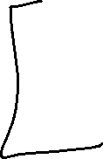
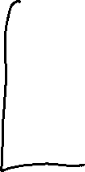

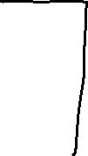
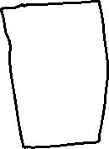

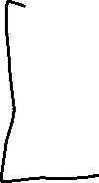


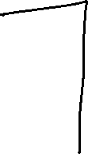



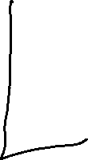


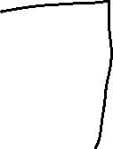
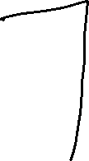
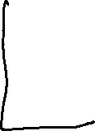
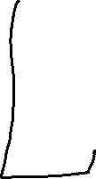

Slide 19
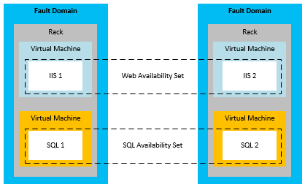

Slide 20
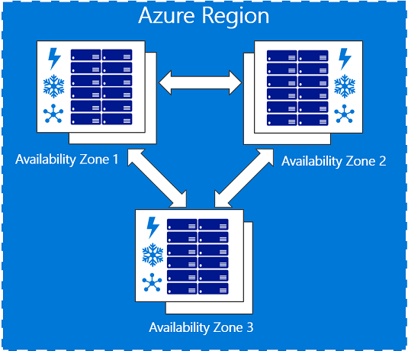
Availability Zones

Slide 21
SLA
Single VM with a Premium Disk – 99.90%
Availability Sets – 99.95%
Availability Zones – 99.99%

Slide 22
Virtual Machine Scale Set
Azure compute resource you can use to deploy and manage a set of identical VMs.
True auto scale, no pre-provisioning of VMs required.

Slide 23
Benefits of VMSS
Same base OS image and configuration
Azure load balancer – layer 4 and application gateway – layer 7
Scale set allows to run multiple instances of application
Customer demand can be met
Scale set supports upto 1000 VMs instances.

Slide 24
Autoscale
Scale In
Scale Out
Schedule events
Less overhead

